Slide 1
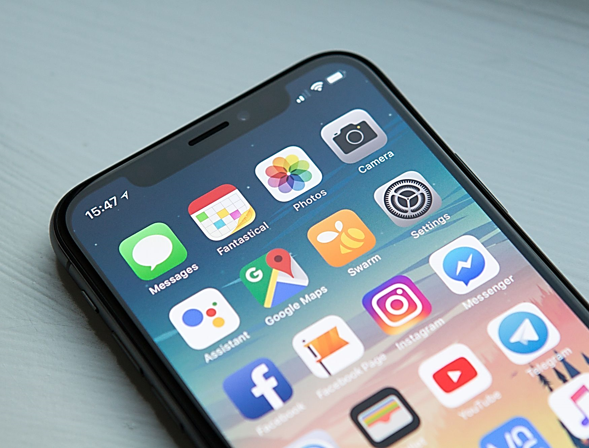
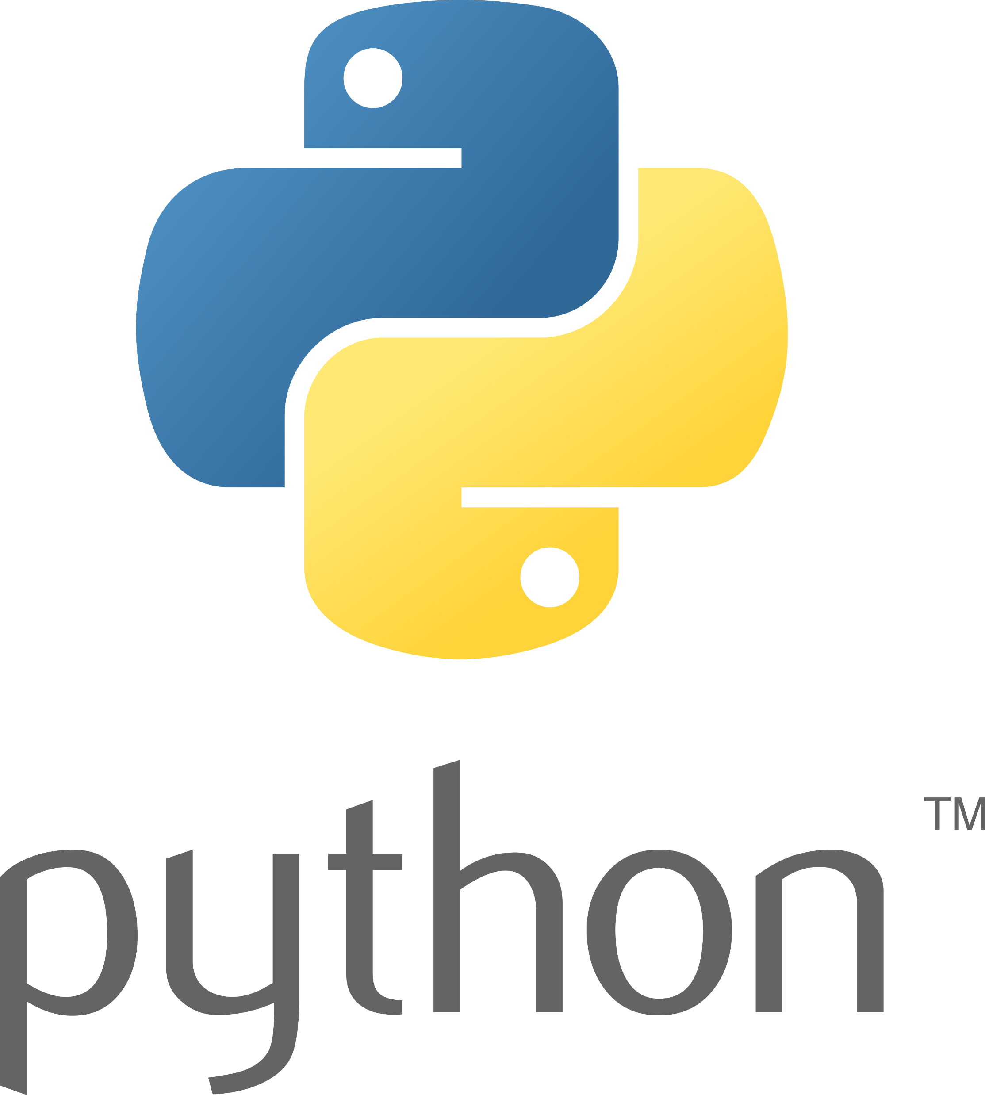

Mobile Apps Programming
P E D Putra, M.Si.
Lecture 3 – Themes, Color Palletes, and Text Field

Slide 2

Themes in Kivy
`theme_cls.theme_style`
is an attribute that belongs to the MDApp class and is part of the theming system.
Purposes
used to set the theme style of the application
Possible Values
This attribute is often used in the build method of the MDApp class, where we initialize the apps
Possible Values
Common values include "Light," "Dark," "Purple," etc
self.theme_cls.theme_style = "Dark"
main1.py
main1.kv
from kivy.lang import Builder
from kivymd.app import MDApp
class MyApp(MDApp):
def build(self):
xxxxxxxxxxx
return Builder.load_file('main6.kv')
if __name__ == '__main__':
MyApp().run()
MDFloatLayout:
MDFlatButton:
text: "Press me"
pos_hint: {"center_x": .5, "center_y": .5}

Slide 3
Themes & Color Palletes in KivyMD
By adding `canvas.before` instruction to the MDFloatLayout. This allows us to set the background color by defining a Color instruction with the desired RGBA values.
main2.py
bkg.kv
from kivy.lang import Builder
from kivymd.app import MDApp
class MyApp(MDApp):
def build(self):
self.theme_cls.theme_style = "Dark" # Set the theme to Dark
return Builder.load_file('bkg.kv')
if __name__ == '__main__':
MyApp().run()
MDFloatLayout:
canvas.before:
Color:
rgba: 0.2, 0.2, 0.2, 1
Rectangle:
pos: self.pos
size: self.size
MDFlatButton:
text: "Press me"
pos_hint: {"center_x": .5, "center_y": .5}

Slide 4
Themes & Color Palletes in KivyMD
theme_style_switch_animation
main3.kv
Animate app colors when switching app color scheme (‘Dark/light’).
MDScreen:
MDCard:
orientation: "vertical"
padding: 0, 0, 0 , "36dp"
size_hint: .5, .5
pos_hint: {"center_x": .5, "center_y": .5}
elevation: 2
shadow_offset: 0, -2
MDLabel:
text: "Theme style - {}".format(app.theme_cls.theme_style)
halign: "center"
valign: "center"
bold: True
font_style: "H5"
MDRaisedButton:
text: "Set theme"
on_release: app.switch_theme_style()
pos_hint: {"center_x": .5}
main3.py
from kivy.lang import Builder
from kivymd.app import MDApp
class Example(MDApp):
def build(self):
self.theme_cls.theme_style_switch_animation = True
self.theme_cls.theme_style = "Dark"
self.theme_cls.primary_palette = "Orange"
return Builder.load_string(KV)
def switch_theme_style(self):
self.theme_cls.primary_palette = ("Orange" if self.theme_cls.primary_palette == "Red" else "Red")
self.theme_cls.theme_style = ("Dark" if self.theme_cls.theme_style == "Light" else "Light")
Example().run()

Slide 5
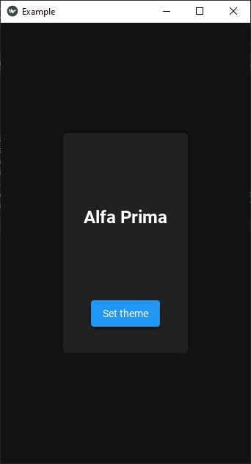
Themes & Color Palletes in KivyMD
Changes the code so that you get this

Slide 6
Themes & Color Palletes in KivyMD
use the Image widget in the KV language to display an image as the background
Place it inside the `MDFloatLayout`
Image:
source: 'path/to/your/image.jpg’
allow_stretch: True
keep_ratio: False
Setting keep_ratio to True will maintain the original aspect ratio of the image while allowing it to stretch or shrink within the available space.

Slide 7
Text Field in KivyMD
In KivyMD, the MDTextField widget is used to create text input fields
main5.py
mai5.kv
from kivymd.app import MDApp
from kivymd.uix.screen import Screen
from kivy.lang import Builder
class DemoApp(MDApp):
def build(self):
self.theme_cls.primary_palette = "Green"
return Builder.load_file('main5.kv')
DemoApp().run()
Screen:
MDTextField:
hint_text: "Enter username"
pos_hint: {'center_x': 0.5, 'center_y': 0.5}
size_hint_x: None
width: 200

Slide 8
Text Field in KivyMD
Working with `helpers`
helpers.kv
username_input = """
MDTextField:
hint_text: "Enter username"
helper_text: "or click on forgot username"
helper_text_mode: "on_focus"
icon_right: "android"
icon_right_color: app.theme_cls.primary_color
pos_hint:{'center_x': 0.5, 'center_y': 0.5}
size_hint_x:None
width:300
"""
main6.py
from kivymd.app import MDApp
from kivymd.uix.screen import Screen
import helpers
from kivy.lang import Builder
class DemoApp(MDApp):
def build(self):
self.theme_cls.primary_palette="Green"
screen = Screen()
username = Builder.load_string(helpers.username_input)
screen.add_widget(username)
return screen
DemoApp().run()

